Slide 1
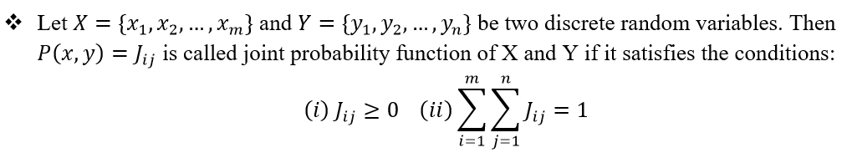
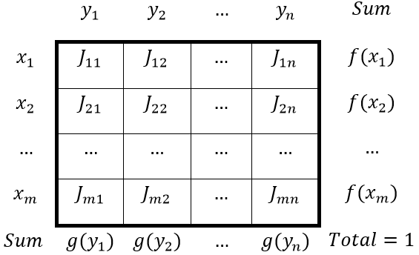
Joint Probability Distribution Function

Slide 2
If X and Y are discrete random variables, the joint probability distribution of X and Y is a description of the set of points (x,y) in the range of (X,Y) along with the probability of each point.
The joint probability distribution of two discrete random variables is sometimes referred to as the bivariate probability distribution or bivariate distribution.
Thus we can describe the joint probability distribution of two discrete random variables is through a joint probability mass function
f(x,y)=P(X=x,Y=y)
2

Slide 3
We often want to determine the joint probability of two variables, such as X and Y. Suppose we are able to determine the following information for education (X) and age (Y) for all Indian citizens based on the census.
Age (Y): Education (X) | Age : 25-35 30 | Age: 35-55 45 | Age: 55-85 70
None 0 | .01 | .02 | .05
Primary 1 | .03 | .06 | .10
Secondary 2 | .18 | .21 | .15
College 3 | .07 | .08 | .04
3

Slide 4
Each cell is the relative frequency (f/N).
We can define the joint probability distribution as:
p(x, y)= Pr(X = x and Y = y)
Example: what is the probability
of getting a 30 year old college
graduate?
p(x,y) = Pr(X=3 and Y=30) = .07
We can see that: p(x) = Σ_{y} p(x,y)
p(x=1) = .03 + .06 + .10 = .19
Age (Y): Education (X) | Age : 25-35 30 | Age: 35-55 45 | Age: 55-85 70
None 0 | .01 | .02 | .05
Primary 1 | .03 | .06 | .10
Secondary 2 | .18 | .21 | .15
College 3 | .07 | .08 | .04
4

Slide 5
Marginal Probability
We call this the marginal probability because it is calculated by summing across rows or columns and is thus reported in the margins of the table.
We can calculate this for our entire table.
Age (Y): Education (X) | 30 | 45 | 70 | p(x)
None: 0 | .01 | .02 | .05 | .08
Primary: 1 | .03 | .06 | .10 | .19
Secondary: 2 | .18 | .21 | .15 | .54
College: 3 | .07 | .08 | .04 | .19
p(y) | .29 | .37 | .34 | 1
5

Slide 7
Marginal Distribution

Slide 8
Conditional Distribution

Slide 9

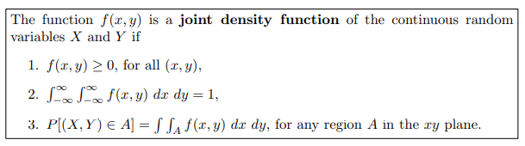
Joint Density Function
9

Slide 10
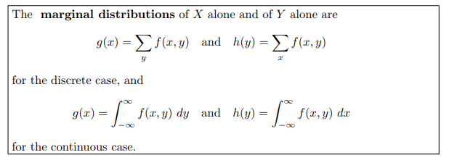
Marginal Distributions
10

Slide 11
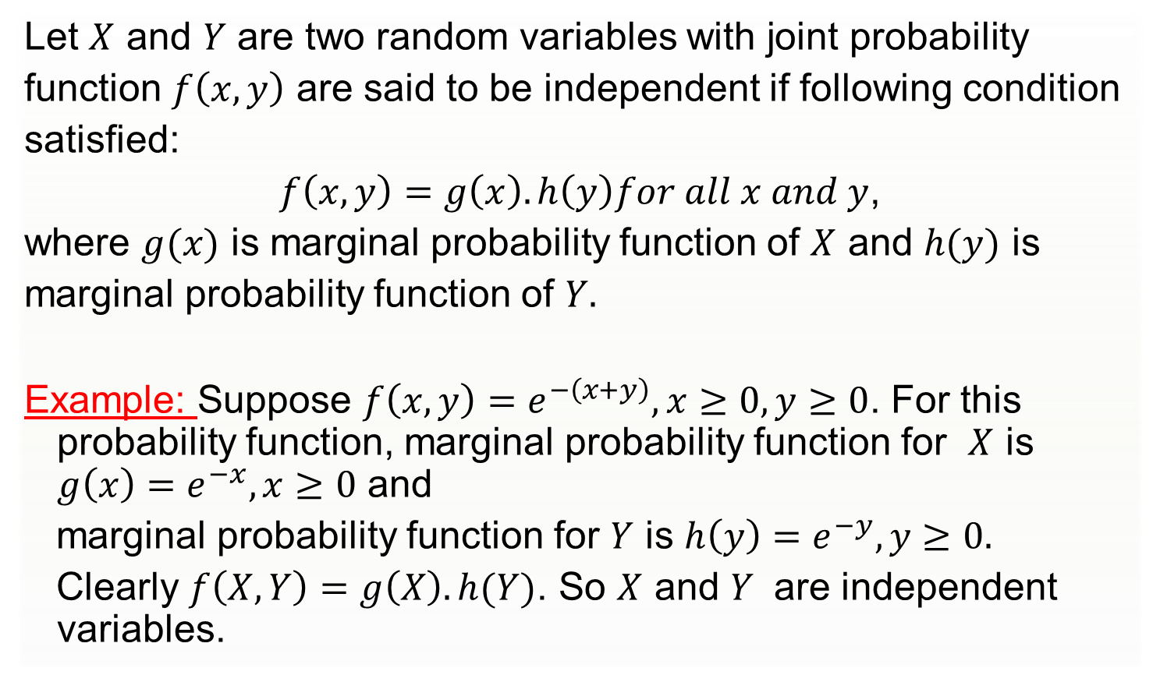
Independent Random Variables
Let $X$ and $Y$ are two random variables with joint probability
function $f\left(x,y\right)$ are said to be independent if following condition
satisfied:
$f\left(x,y\right)=g\left(x\right).h\left(y\right)for all x and y$,
where $g(x)$ is marginal probability function of $X$ and $h(y)$ is
marginal probability function of $Y.$
Example: Suppose $f\left(x,y\right)=e^{−\left(x+y\right)}, x≥0, y≥0$. For this probability function, marginal probability function for $X$ is $g\left(x\right)=e^{−x}, x≥0$ and
marginal probability function for $Y$ is ${h\left(y\right)=e}^{−y}, y≥0.$
Clearly $f\left(X,Y\right)=g\left(X\right).h(Y)$. So $X$ and $Y$ are independent variables.
11

Slide 12




Solution:
12

Slide 13





Cont.
13

Slide 14
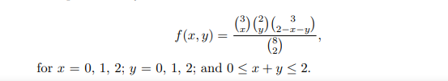
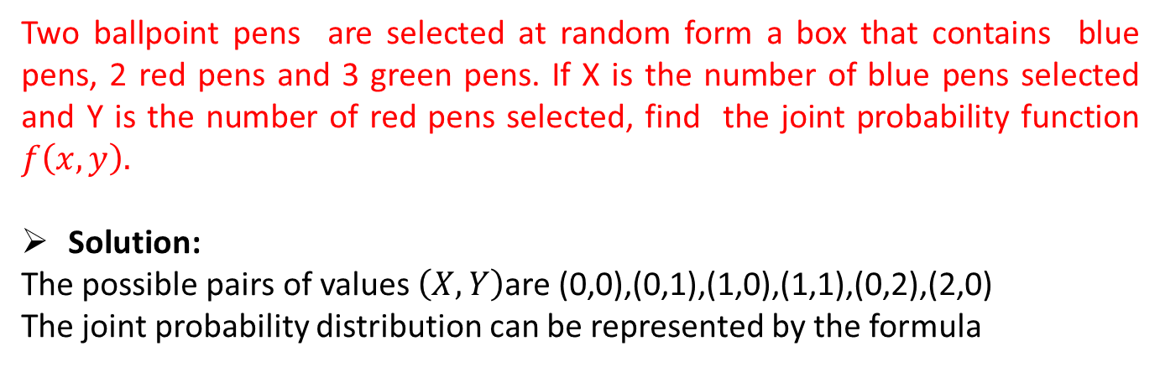
Example:
Two ballpoint pens are selected at random form a box that contains blue pens, 2 red pens and 3 green pens. If X is the number of blue pens selected and Y is the number of red pens selected, find the joint probability function $f\left(x,y\right).$
Solution:
The possible pairs of values $\left(X,Y\right)$are (0,0),(0,1),(1,0),(1,1),(0,2),(2,0)
The joint probability distribution can be represented by the formula
14

Slide 15
Joint distribution
f(x,y) |  | X |  |  | Rows Total
 |  | 0 | 1 | 2
y | 0 | 3/28 | 9/28 | 3/28 | 15/28
 | 1 | 3/14 | 3/14 | 0 | 3/7
 | 2 | 1/28 | 0 | 0 | 1/28
Columns Total |  | 5/14 | 15/28 | 3/28 | 1
15

Slide 16
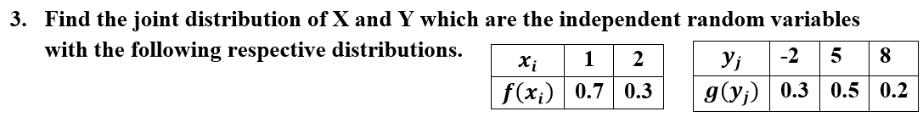

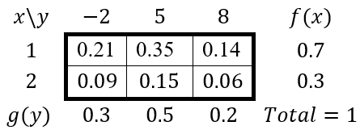
Example
Solution:
16

Slide 17
Example:
A candy company distributed boxes of chocolates with a mixture of creams, toffees, and nuts coated in both light and dark chocolate. For a randomly selected box, let X and Y, respectively, be the proportions of the light and dark chocolates that are creams and suppose that the joint density function is
a) Verify whether
b) Find P[(X,Y) ∈ A], where A is the region {(x,y) | 0<x<½,¼<y<½}
c) Find g(x) and h(y) for the joint density function.
17

Slide 18
Solution
a)
18

Slide 19
Solution..
b)
19

Slide 20
Solution
By definition,
For 0≤x ≤1, and g(x)=0 elsewhere.
Similarly,
For 0 ≤y ≤1, and h(y)=0 elsewhere.
20

Slide 21







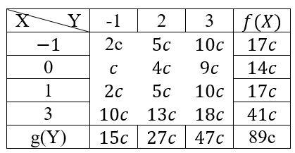




Example
Solution:
21

Slide 22

Cont.
22

Slide 23
Glossary
Random Variable: A variable that takes on numerical values based on the
outcomes of a random experiment.
Discrete Random Variable: A random variable that can take on a countable number of values.
Continuous Random Variable: A random variable that can take on an uncountable range of values, often over an interval.
2. Probability Distribution: A function that describes the likelihood of different
outcomes for a random variable.
Probability Mass Function (PMF): A function that gives the probability of each value of a discrete random variable.
Probability Density Function (PDF): A function that represents the likelihood of different values of a continuous random variable.
3. Expected Value (Mean): The average value a random variable is expected to take,
calculated as a weighted sum or integral of its possible values.
4. Variance: A measure of how spread out the values of a random variable are around the mean.
23

Slide 24
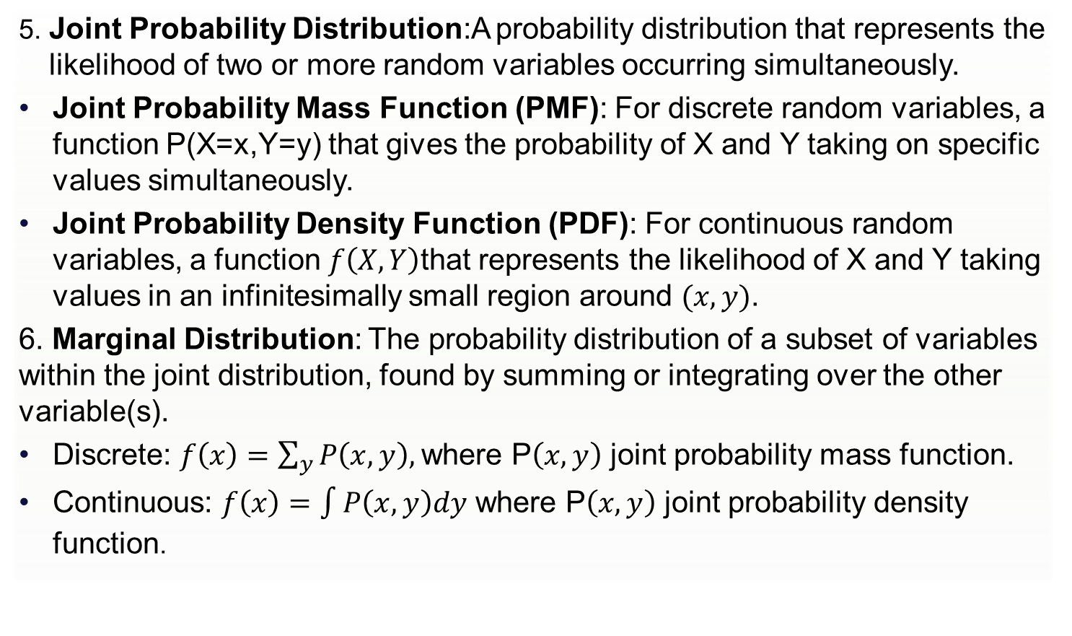
Glossary
5. Joint Probability Distribution:A probability distribution that represents the likelihood of two or more random variables occurring simultaneously.
Joint Probability Mass Function (PMF): For discrete random variables, a function P(X=x,Y=y) that gives the probability of X and Y taking on specific values simultaneously.
Joint Probability Density Function (PDF): For continuous random variables, a function $f\left(X,Y\right)$that represents the likelihood of X and Y taking values in an infinitesimally small region around $(x,y)$.
6. Marginal Distribution: The probability distribution of a subset of variables within the joint distribution, found by summing or integrating over the other variable(s).
Discrete: $f\left(x\right)=\sum_{y}{P\left(x,y\right), }$where P$\left(x,y\right)$ joint probability mass function.
Continuous: $f\left(x\right)=$ $\int{P\left(x,y\right)dy}$ where P$\left(x,y\right)$ joint probability density function.
24

Slide 25
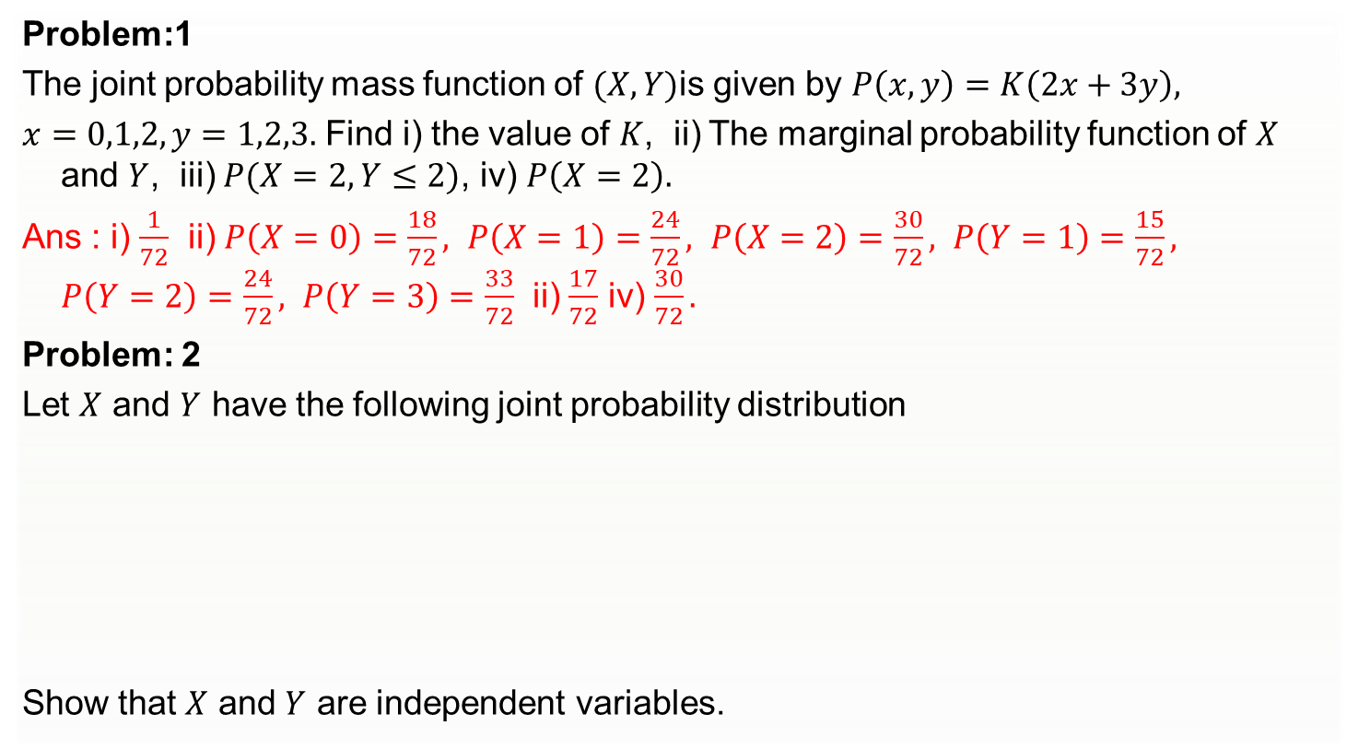
Practice Problems-set 2
Problem:1
The joint probability mass function of $(X,Y)$is given by $P\left(x,y\right)=K\left(2x+3y\right),$
$x=0,1,2,y=1,2,3.$ Find i) the value of $K$, ii) The marginal probability function of $X$ and $Y$, iii) $P(X=2,Y≤2)$, iv) $P\left(X=2\right).$
Ans : i) $\frac{1}{72}$ ii) $P\left(X=0\right)=\frac{18}{72}, P\left(X=1\right)=\frac{24}{72}, P\left(X=2\right)=\frac{30}{72}, P\left(Y=1\right)=\frac{15}{72}, P\left(Y=2\right)=\frac{24}{72}, P\left(Y=3\right)=\frac{33}{72}$ ii) $\frac{17}{72}$ iv) $\frac{30}{72}.$
Problem: 2
Let $X$ and $Y$ have the following joint probability distribution
Show that $X$ and $Y$ are independent variables.
X Y | 2 | 4
1 | 0.10 | 0.15
3 | 0.20 | 0.30
5 | 0.10 | 0.15
25

Slide 26
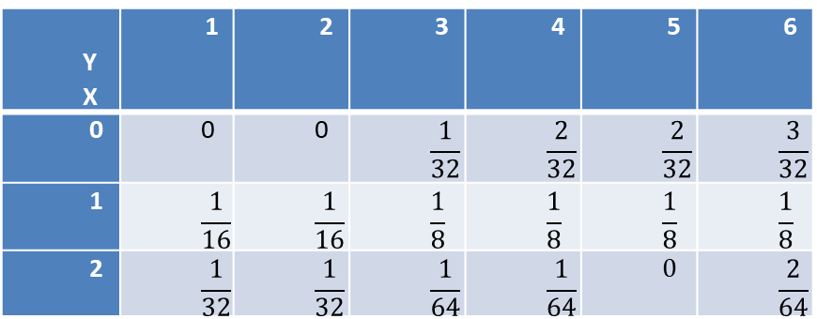
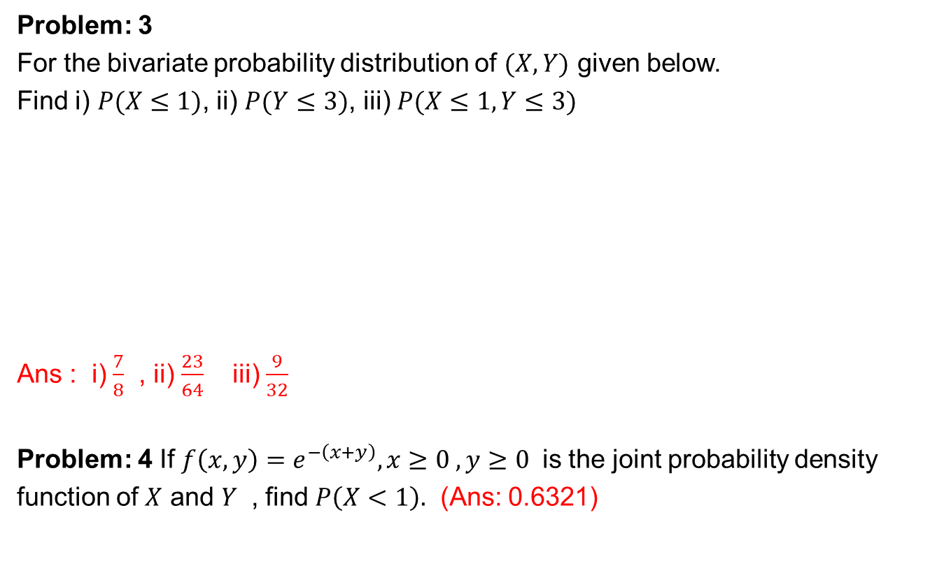
Problem: 3
For the bivariate probability distribution of $(X,Y)$ given below.
Find i) $P(X≤1)$, ii) $P(Y≤3)$, iii) $P(X≤1, Y≤3)$
Ans : i) $\frac{7}{8}$ , ii) $\frac{23}{64}$ iii) $\frac{9}{32}$
Problem: 4 If $f\left(x,y\right)=e^{−\left(x+y\right)}, x≥0 , y≥0$ is the joint probability density
function of $X$ and $Y$ , find $P\left(X<1\right).$ (Ans: 0.6321)
Y X | 1 | 2 | 3 | 4 | 5 | 6
0 | 0 | 0 | $$\frac{1}{32}$$ | $$\frac{2}{32}$$ | $$\frac{2}{32}$$ | $$\frac{3}{32}$$
1 | $$\frac{1}{16}$$ | $$\frac{1}{16}$$ | $$\frac{1}{8}$$ | $$\frac{1}{8}$$ | $$\frac{1}{8}$$ | $$\frac{1}{8}$$
2 | $$\frac{1}{32}$$ | $$\frac{1}{32}$$ | $$\frac{1}{64}$$ | $$\frac{1}{64}$$ | $$0$$ | $$\frac{2}{64}$$
26

Slide 27
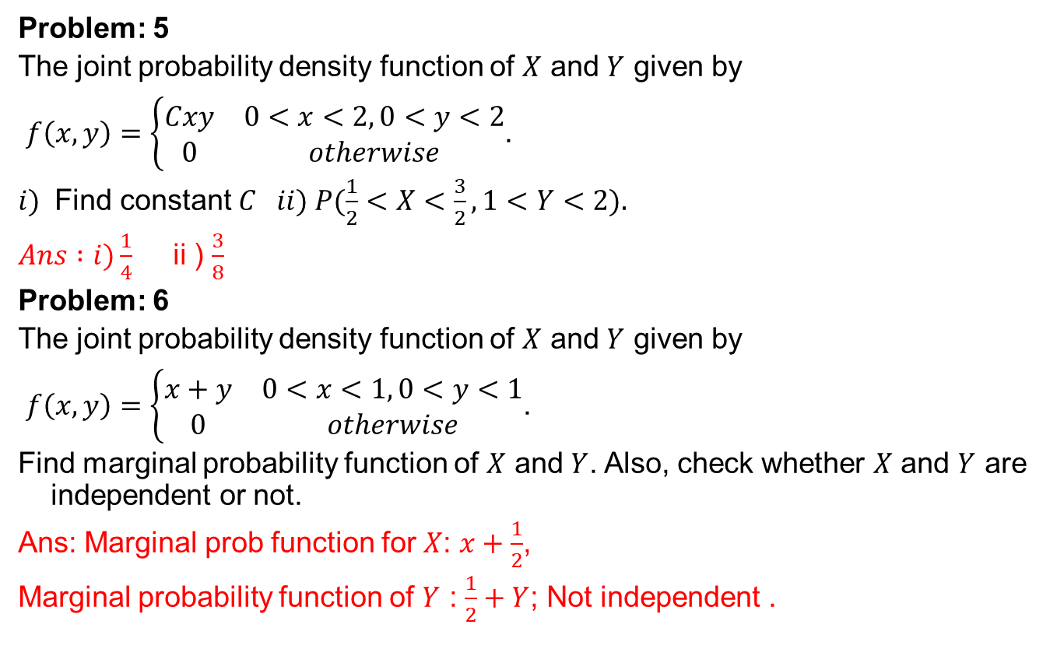
Problem: 5
The joint probability density function of $X$ and $Y$ given by
$f\left(x,y\right)=\left\{\begin{matrix}Cxy & 0<x<2, 0<y<2 \\ 0 & otherwise\end{matrix}\right.$.
$i)$ Find constant $C ii) P(\frac{1}{2}<X<\frac{3}{2}, 1<Y<2).$
$Ans :i)\frac{1}{4}$ ii ) $\frac{3}{8}$
Problem: 6
The joint probability density function of $X$ and $Y$ given by
$f\left(x,y\right)=\left\{\begin{matrix}x+y & 0<x<1, 0<y<1 \\ 0 & otherwise\end{matrix}\right.$.
Find marginal probability function of $X$ and $Y$. Also, check whether $X$ and $Y$ are independent or not.
Ans: Marginal prob function for $X$: $x+\frac{1}{2}$,
Marginal probability function of $Y$ : $\frac{1}{2}+Y$; Not independent .
27

Slide 28

IMP Note to Self

Slide 29
Thank You !

